Slide 1
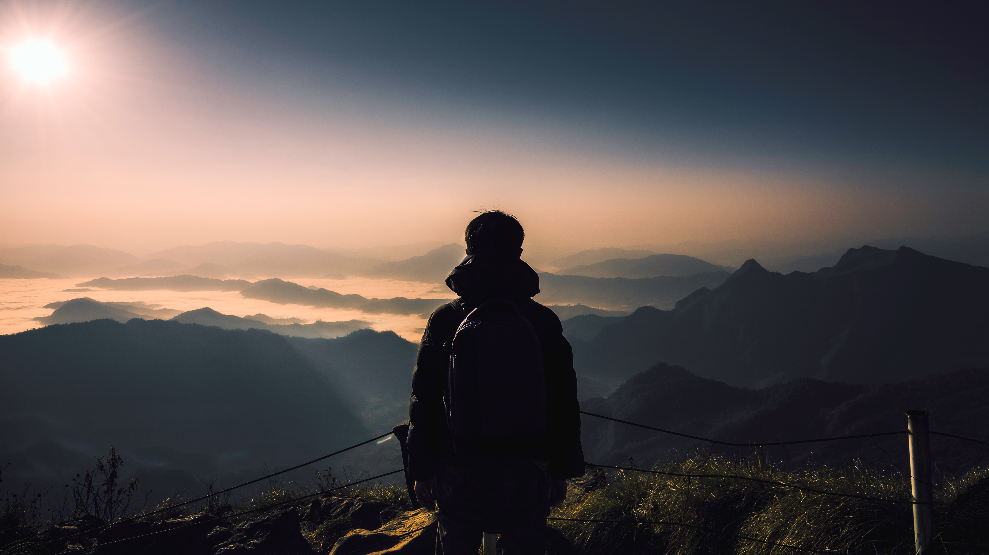
Welcome everyone
Topic : when in Rome do as Rome do

Slide 2

When in Rome do as Rome do means?
Following the customs and tradition of other countries
It's good to do things the way people there do.
It's like a little gift we give to show we care about their culture.

Slide 3
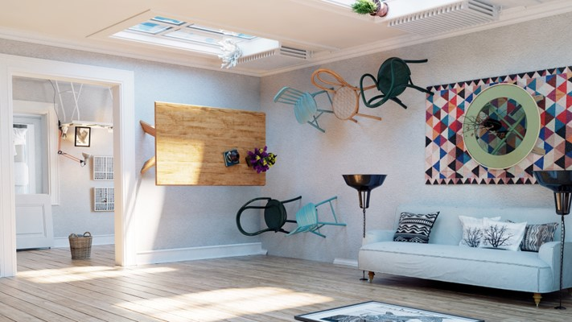
Why is this important?
Well, think of it like this: when you go to a friend's house, you follow their rules, right? You wouldn't jump on their couch if they don't like it. It's kind of like that but for whole cities or countries!

Slide 4



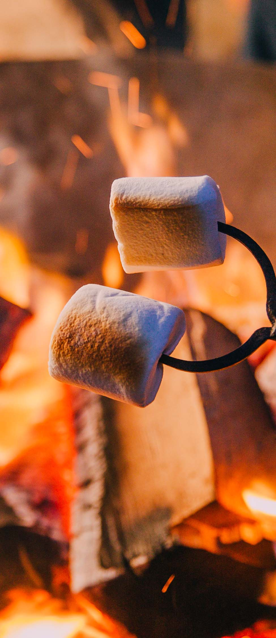
Slide 1
Its about being open minded
It's also about being open-minded and learning from others. Just like when you play a new game, you watch and learn the rules from your friends. When we're in a new place, we can learn a lot by doing things the way locals do.
Week 3
Week 4
Arizona
California

Slide 5
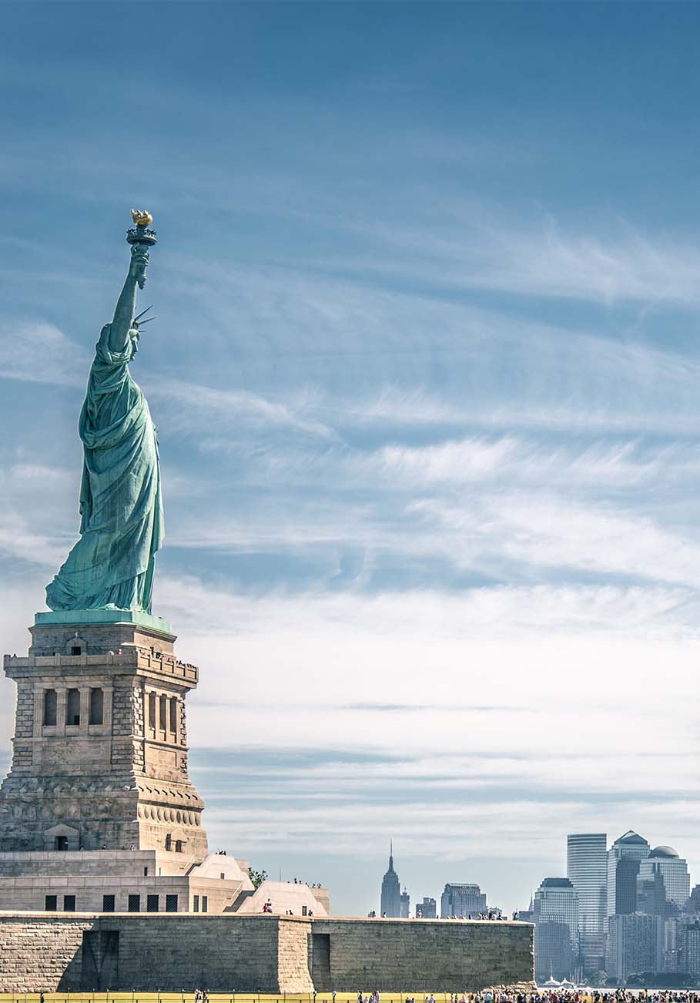
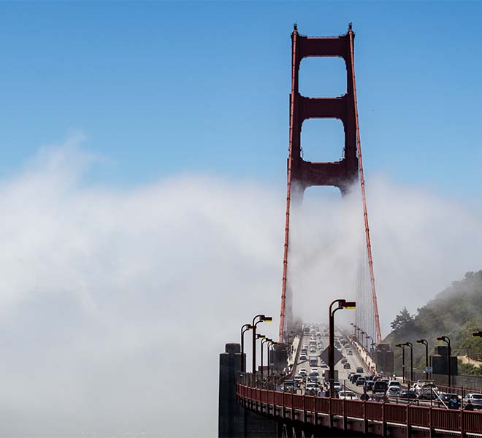


And guess what?
This helps us make friends! People like it when we respect their way of doing things. It's like a little gift we give to show we care about their culture.

Slide 6
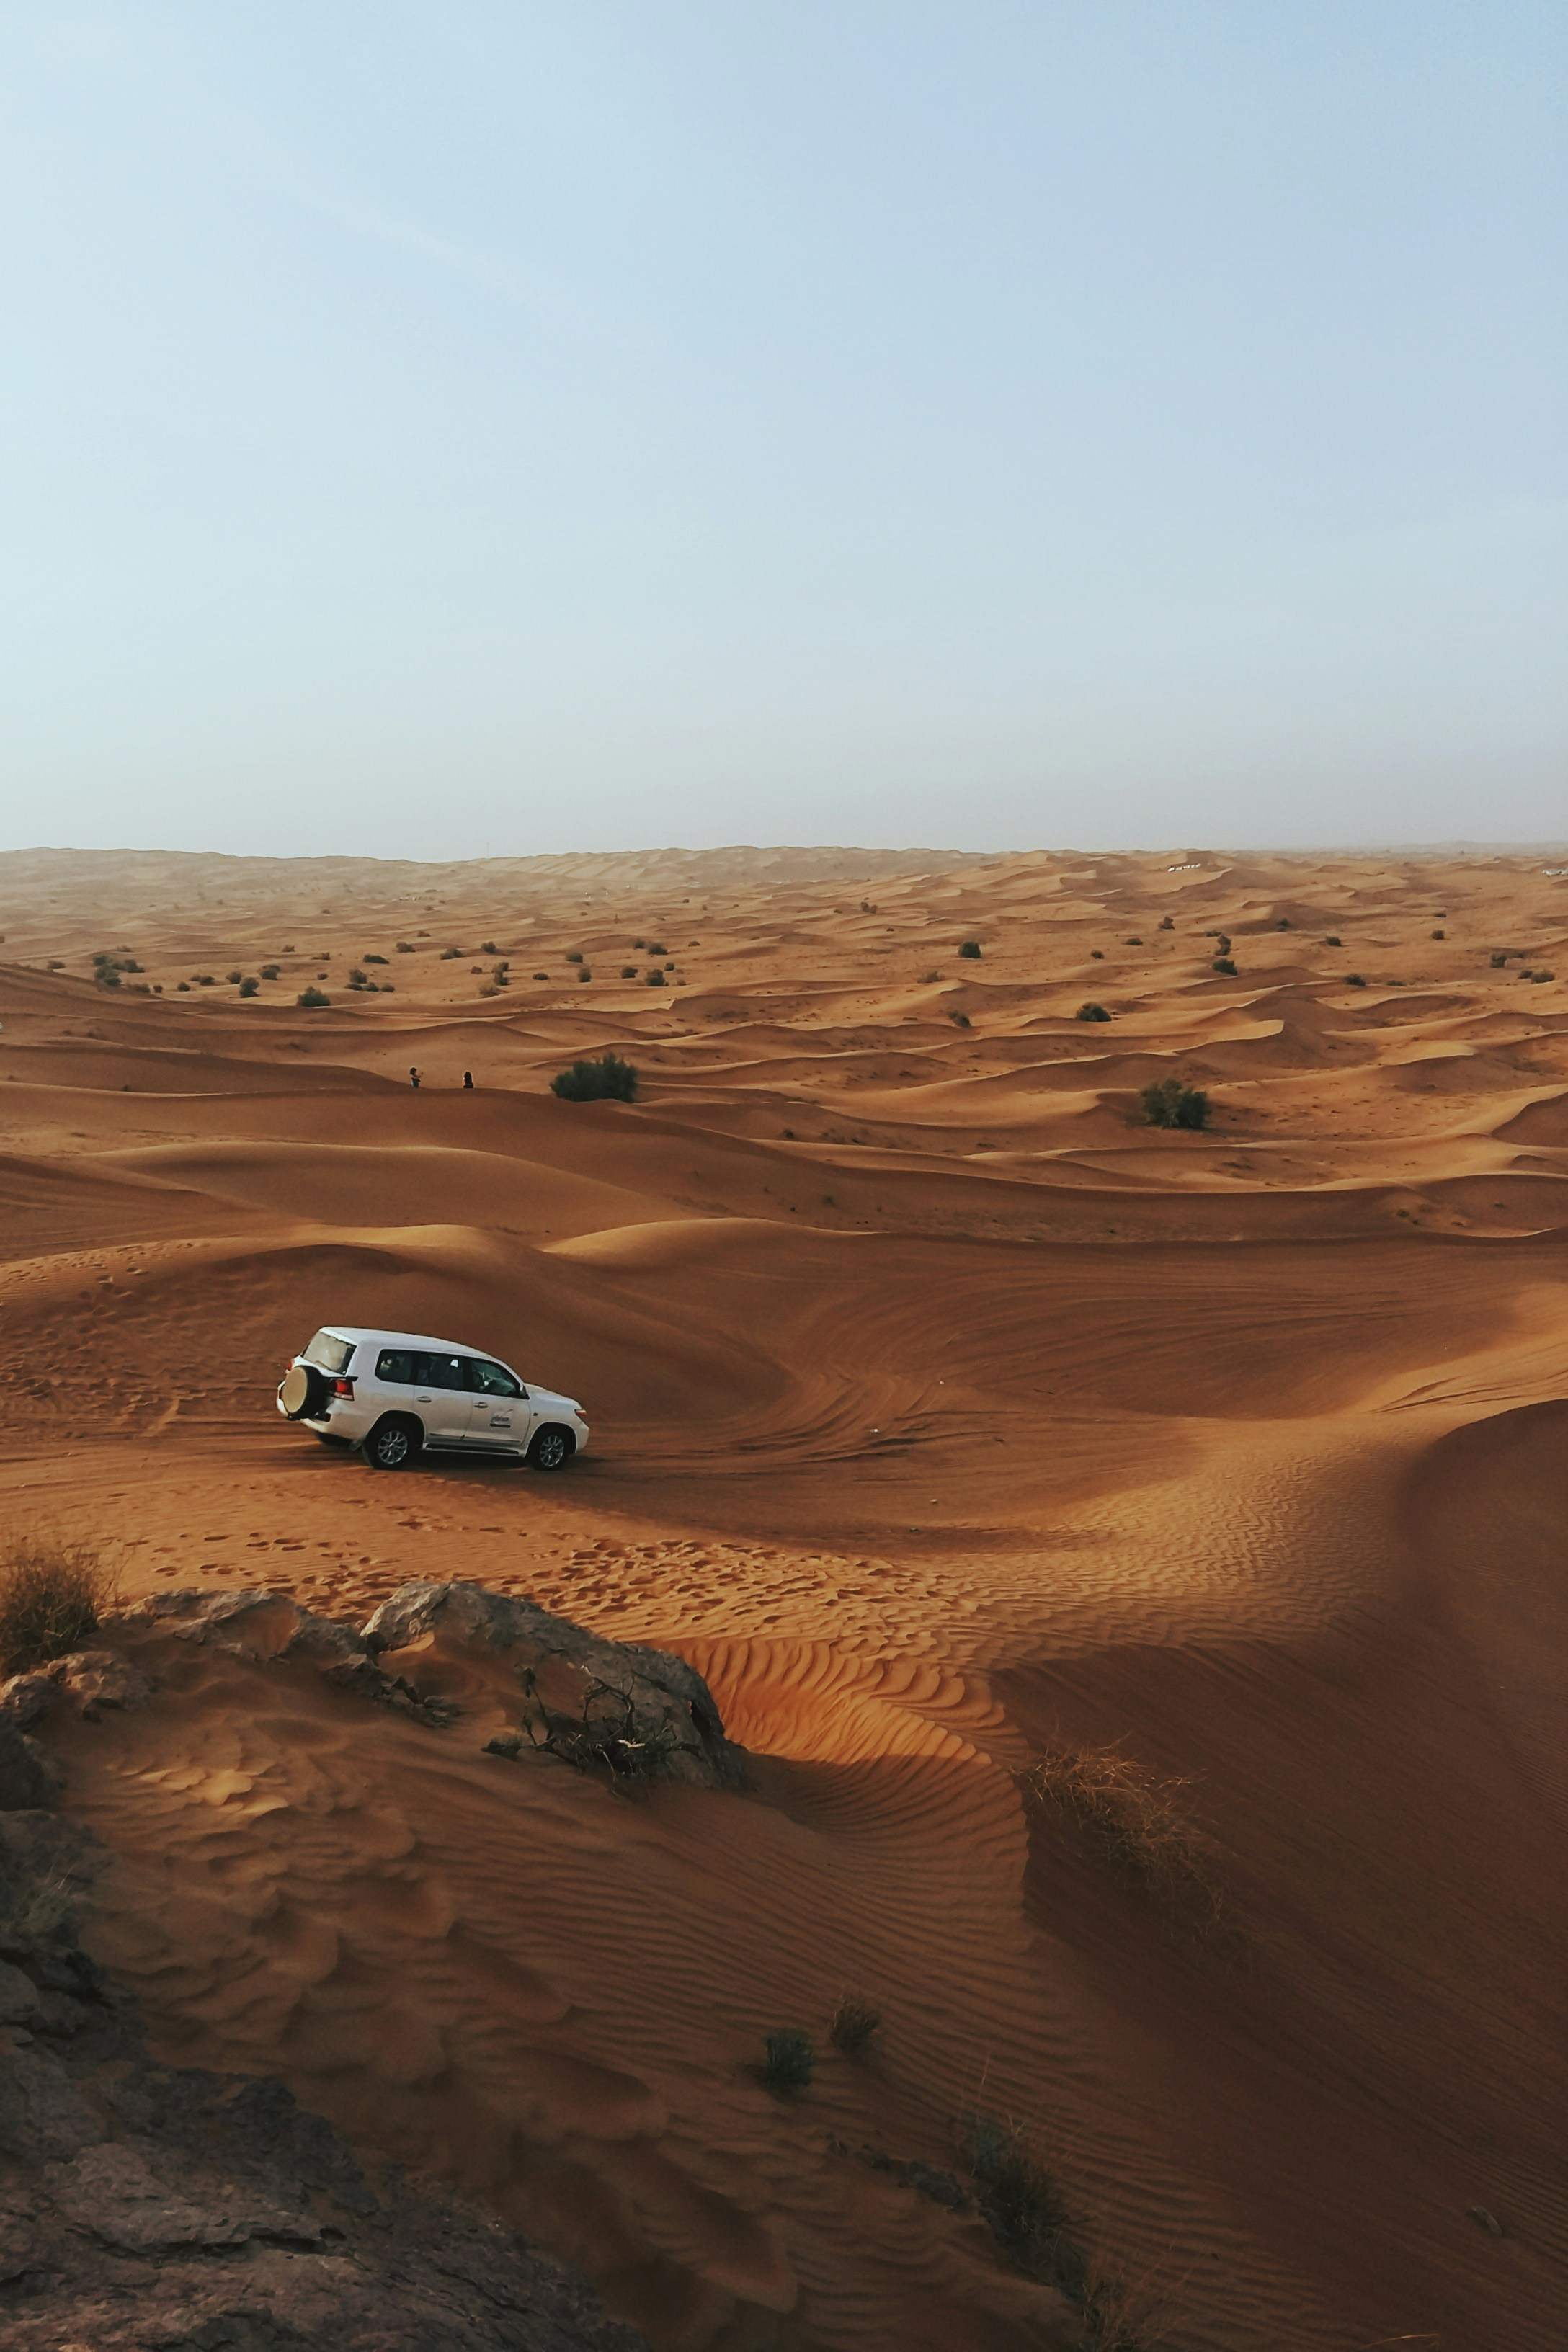

Slide 1
secret code
So, next time you're in a new place, remember this saying: "When in Rome, do as the Romans do." It's like a secret code for making friends and having a great time in different parts of the world.
Week 3
Week 4
Arizona
California

Slide 7
Thank you for
Listening and watching
Made by :sana shahid
Berlitz level:5
Berkley

